Slide 1


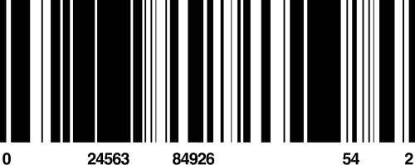
GROUP 2
PREDICTING FLIGHT TICKET PRICES
INSTRUCTOR - PROF SATANIK MITRA

Slide 2



INTRODUCTION
In today’s competitive airline industry, accurate airfare forecasting is a key lever for revenue maximization. Ticket pricing is influenced by a multitude of factors, from time to departure and seat availability to travel class and market competition. For airlines, adopting data-driven approaches to predict flight prices offers a competitive advantage by enabling dynamic pricing strategies that optimize load factors and profit margins.
This project aims to forecast flight ticket prices using machine learning techniques to enhance airline revenue management, optimize dynamic pricing strategies, and support data-driven operational decision-making.

Slide 3
DATASET DESCRIPTION
Dataset contains information about flight booking options from the website Easemytrip for flight travel between India's top 6 metro cities. Initially we had -
No. of Rows - 300153
No. of Columns - 12

Slide 4
STEP#1
DATA PRE- PROCESSING

Slide 5

Verified absence of null values
1
DATA CLEANING
Eliminated 2 redundant columns (Flight, 0 Header)
2
FEATURE ENGINEERING
Label Encoder - Used to convert categorical data into a numerical format by assigning each unique category a distinct integer
3
FEATURE STANDARDIZATION
Standardize features by removing the mean and scaling to unit variance.
4
MULTI COLLINEARITY CHECK
VIF Check - Values showed no significant multicollinearity, ensuring that the features were independent of each other (<5)

Slide 6
STEP #2
DATA MODELING
AND EVALUATION

Slide 7
DATA MODELING
LINEAR REGRESSION
RIDGE
REGRESSION
RANDOM FOREST
XG BOOSTING
A baseline model to assess linear relationships
A regularized linear model to reduce multicollinearity and overfitting.
An ensemble-based model capable of capturing non-linear patterns in complex datasets.
An ensemble-based model which builds decision trees in a sequential manner to minimize errors
MSE: 4.572
R² Score: 0.91
MSE: 4.572
R² Score: 0.9113
MAE: 1091
R² Score: 0.9849
MAE: 3718.45
R² Score: 0.9437

Slide 8
STEP #3
MODEL
DEPLOYMENT

Slide 9
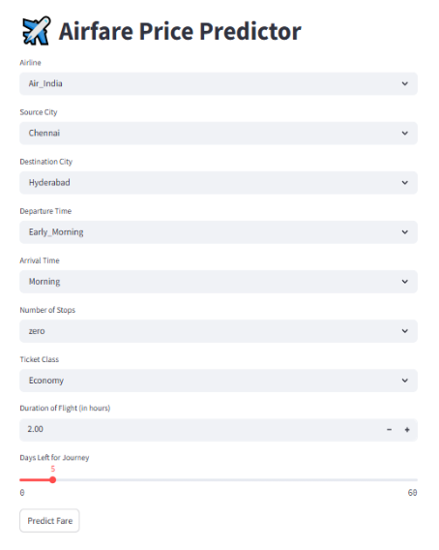
An interactive Streamlit application was developed to enable real-time fare prediction. Users can input flight parameters and instantly receive a predicted price, making the tool practical for consumer decision-making and airline pricing strategy testing.

Slide 10
RESULTS

Slide 11
THE RANDOM FOREST REGRESSOR MODEL ACHIEVED THE BEST PERFORMANCE, WITH AN R² VALUE OF 0.98, INDICATING THAT IT COULD EXPLAIN 98% OF THE VARIANCE IN AIRFARE PRICES. THE MODEL'S MEAN SQUARED ERROR (MAE) OF 1091 CONFIRMS THE ACCURACY OF THE PREDICTIONS.

Slide 12
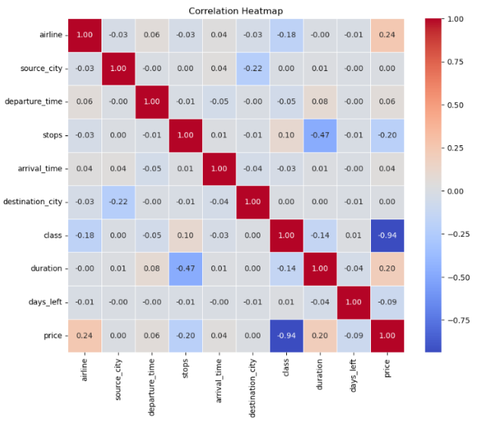
GRAPH #1
Correlation Analysis: Calculate correlation between the features
Class has a strong negative correlation with price (-0.94) – economy tickets are much cheaper than business.
Duration shows a mild positive correlation (0.20) – longer flights tend to cost more.
Airline also shows a mild positive correlation (0.24) – some airlines charge more.
Other features (e.g., source/destination city, departure time) have weak or no correlation with price.

Slide 13
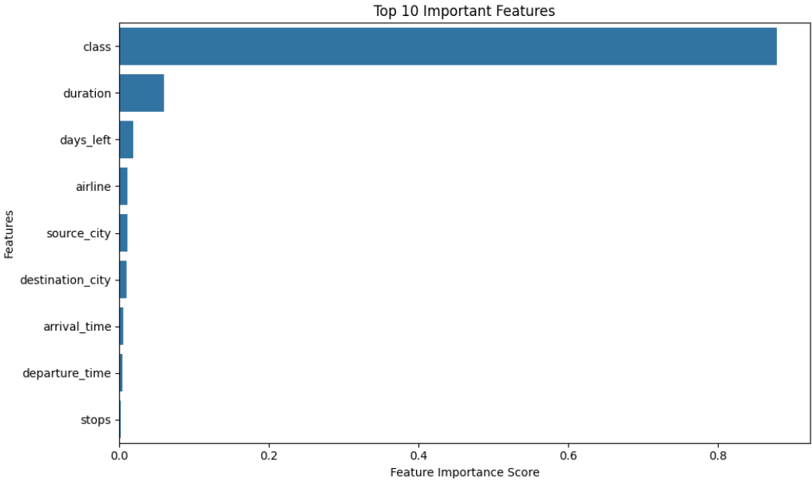
GRAPH #2
Feature Importance Chart:
The feature importance charts show that "class" (economy or business) is by far the most significant factor in predicting flight prices, contributing nearly 90% to the model's decisions. "Duration" and "days_left" have minor influence, while other features contribute very little.

Slide 14
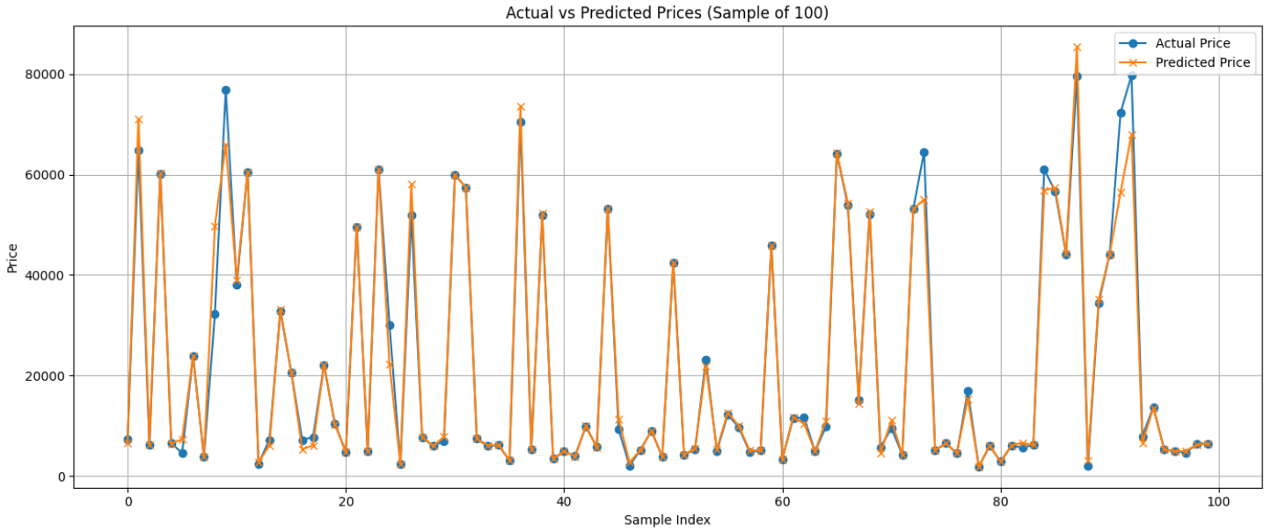
GRAPH #3
Actual vs Predicted Chart:
The predicted prices closely follow the actual prices, showing good model accuracy.
Most deviations are minor, indicating the model generalizes well.
A few large differences exist for high-priced tickets, possibly due to outliers or limited data in that range.

Slide 15
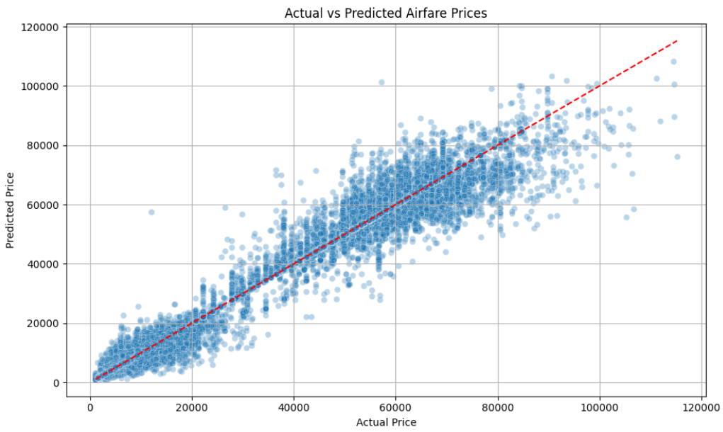
GRAPH #4
Actual vs Predicted Airfare Prices:
The scatter plot shows a strong alignment along the red diagonal line, indicating high prediction accuracy.
Most points cluster closely around the line → model performs well across a wide price range.
Few outliers at higher prices, but overall trend is well captured.

Slide 16
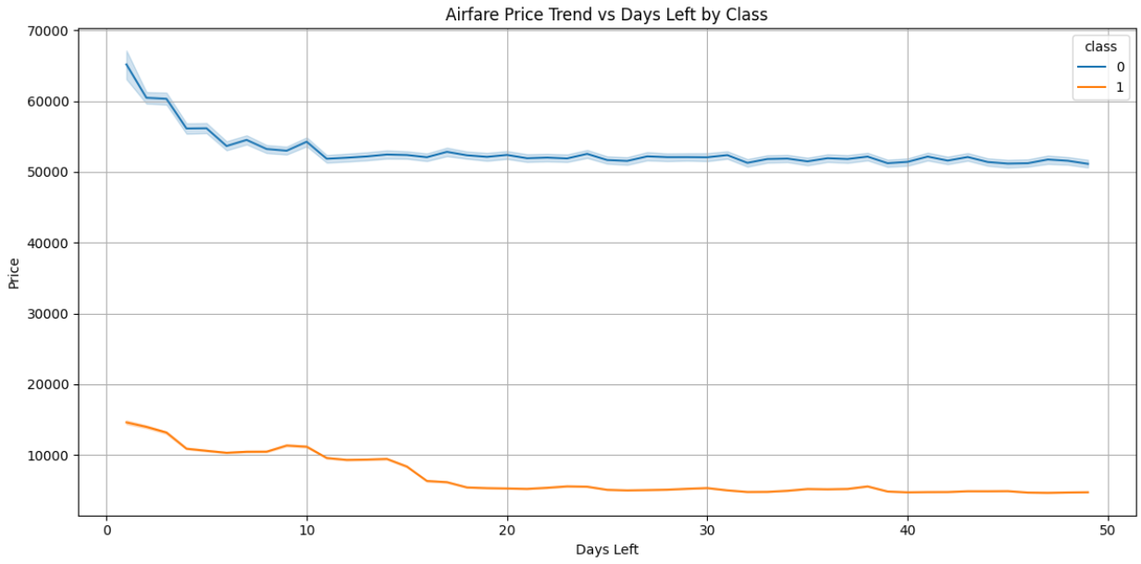
GRAPH #5
Airfare Price vs Days Left (by Class)
Both classes show a decline in prices as days left increase.
Business class (blue) prices are consistently much higher than economy (orange).
Sharpest drop seen in the first 10 days, then prices stabilize.

Slide 17
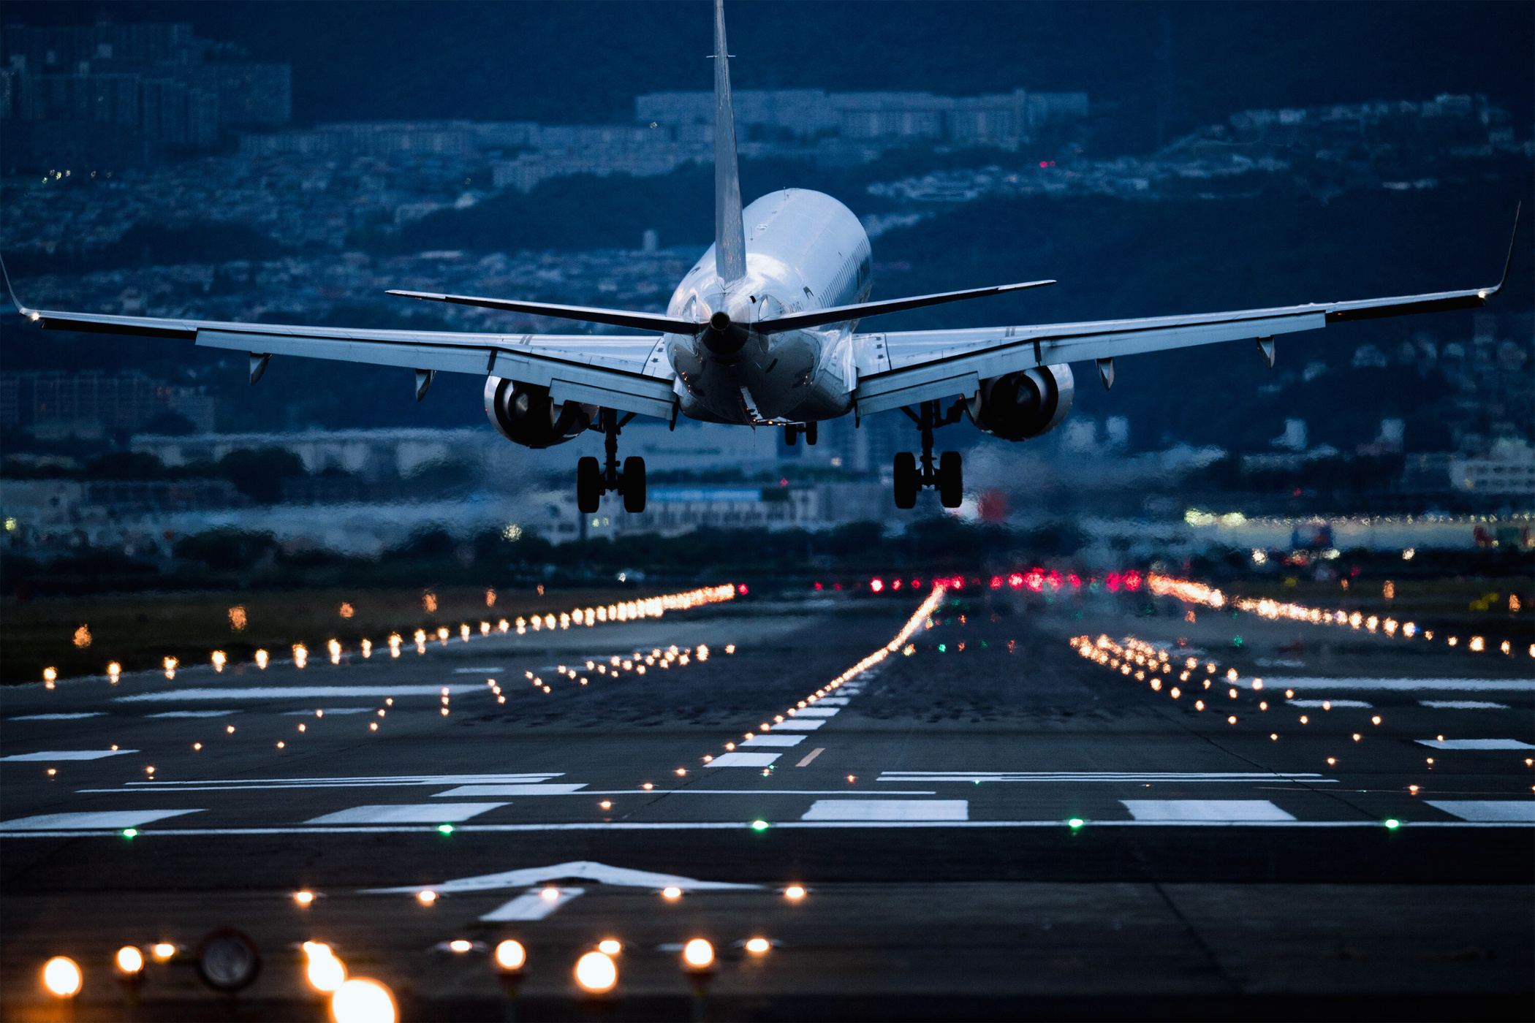
INSIGHTS
The Delhi–Mumbai route appears highly competitive, with major airlines offering similar flight durations (2.0–2.5 hrs) and closely matched last-minute fares (~₹5953–₹5956 for economy).
This reflects a commoditized market, where schedule, convenience, and price drive customer choice over service differences.

Slide 18
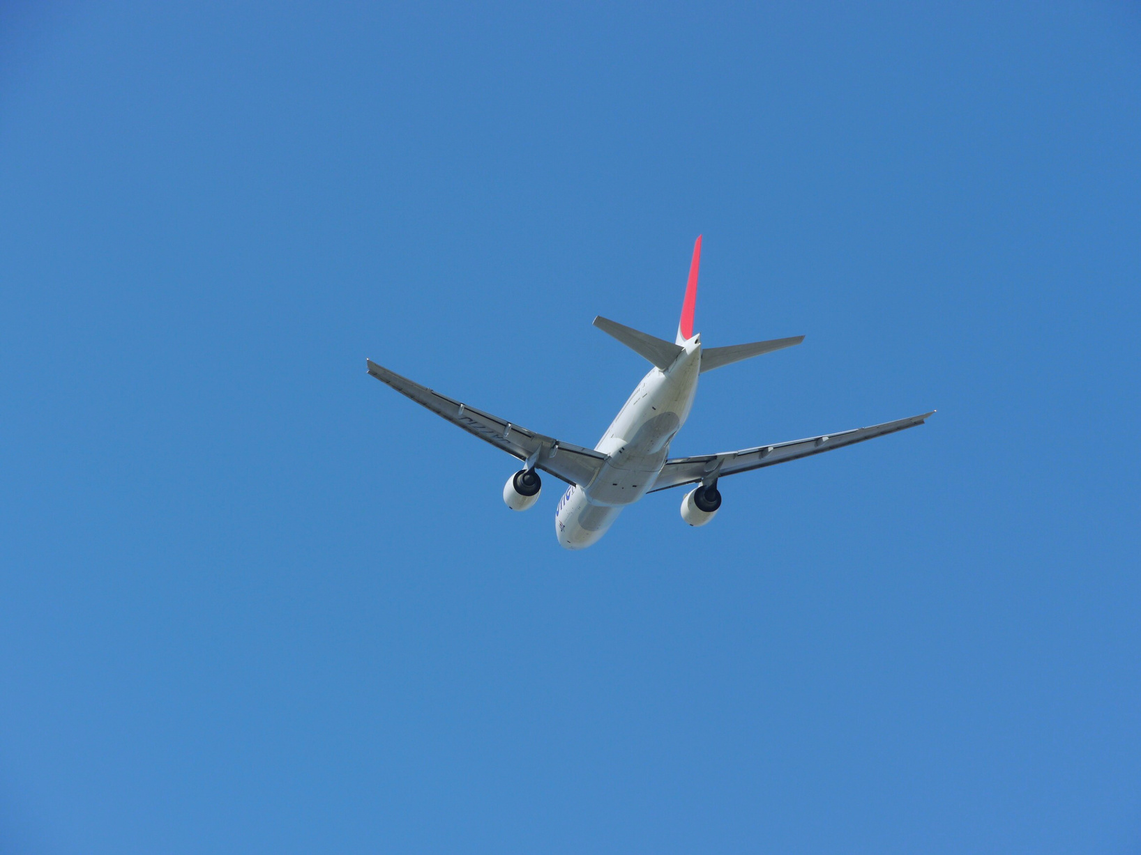
CONCLUSION
Machine learning, especially the Random Forest Regressor, shows strong potential in predicting airfare prices. Key factors include airline and departure time.
A Streamlit app enables users to interactively predict prices. Future improvements may include adding real-time data like demand trends or weather for even better accuracy.

Slide 19
SHREYA GUPTA 2024H1540840P
ANAKARI SRAVYA HADASSA 2024H1540850P
THANKS FOR FLYING WITH US
KRATIKA GARG 2024H1540855P
TARANI SATYA KANDULA 2024H1540861P
AAMINA NOORAIYEEN 2024H1540863P

